Slide 1


CS 153: Concepts of Compiler Design September 3 Class Meeting
Department of Computer Science San Jose State University Fall 2020 Instructor: Ron Mak
www.cs.sjsu.edu/~mak

Slide 2
Simple Interpreter
Now that we have a basic parse tree and a rudimentary symbol table, we can start the backend tier.
Recall the the backend components only work with the intermediate tier components.

Slide 3
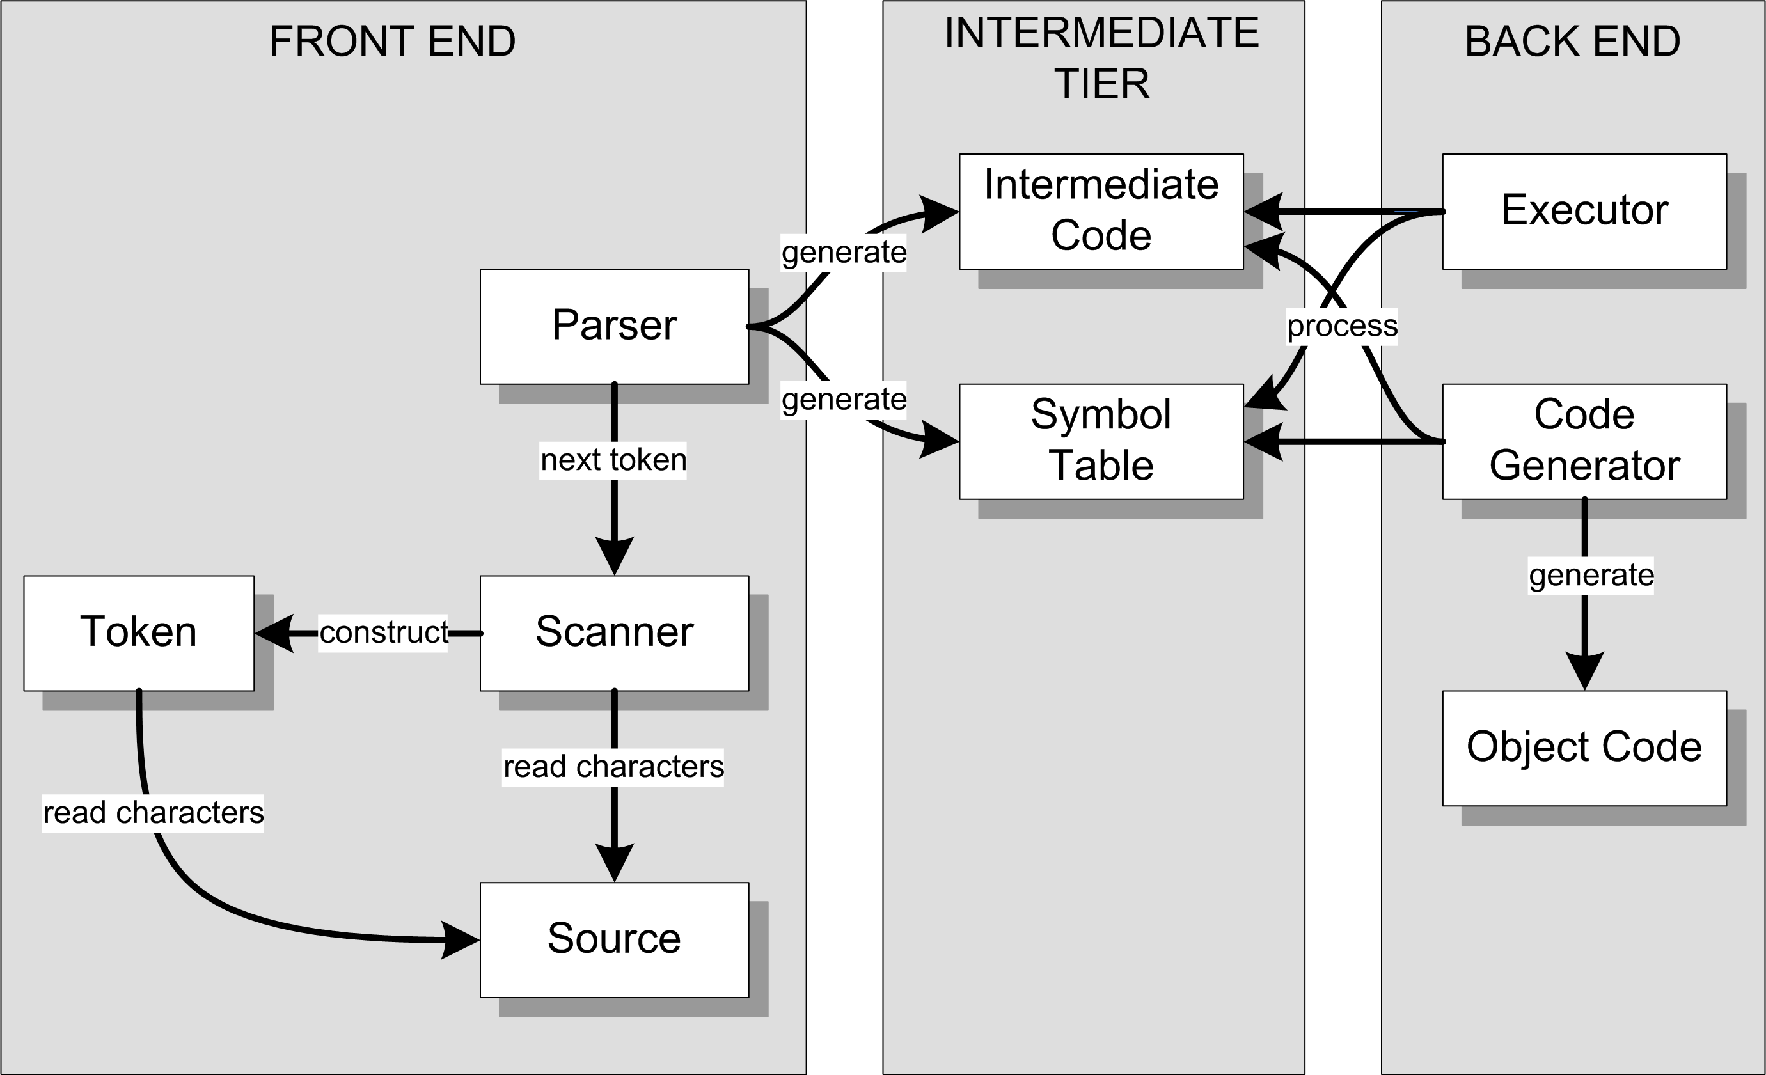
Review: Conceptual Design
Interpreter
Compiler or
converter

Slide 4
What is “Run Time”?
Run time is when the interpreter is executing the source program (e.g., the Pascal program).
This can be confusing because the interpreter itself is running.
Adjective: runtime
During run time, the execution of the source program is under the control of the interpreter.
The executor in the interpreter’s back end relies solely on the parse tree and the symbol table in the intermediate tier (which were built by the parser in the front end).

Slide 5
Use of the Parse Tree at Run Time
The parse tree represents the statements of the source program.
During run time, the executor “visits” the nodes of the tree.
The executor performs certain operations depending on the type of node that it’s visiting.
During a node visit, the executor can also visit the children of the node.

Slide 6
Use of the Symbol Table at Run Time
Each VARIABLE parse tree node contains a link to the variable’s symbol table entry.
Therefore, during the visit of an ASSIGN node, the value of the right-hand-side expression can be stored into the left-hand-side variable’s symbol table entry.
The value of the RHS expression is obtained by visiting the nodes of the expression subtree.
If there is a VARIABLE node in the expression subtree, the value of the variable is obtained from its symbol table entry.

Slide 7
Another Hack!
Storing values calculated during run time into variables’ symbol table entries is a temporary hack we’ll use for now.
This will fail miserably if we have recursion.
We’ll see later where we should actually store calculated runtime values for variables.

Slide 8
Visiting Parse Tree Nodes During Run Time
Class Executor in the backend package contains numerous visit methods for the types of tree nodes:
visitProgram()
visitStatement()
visitCompound()
visitAssign()
visitLoop()
visitTest()
visitExpression()
etc.

Slide 9
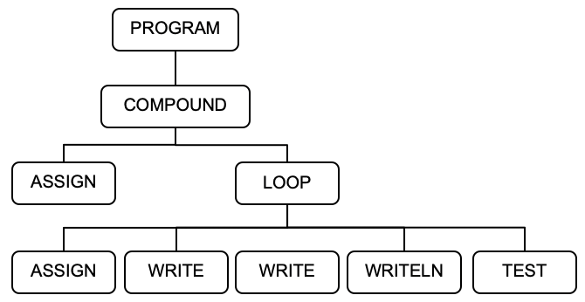
Visiting Parse Tree Nodes, cont’d
To test the backend executor, the main starts things off with a visit of the PROGRAM node:
private static void executeProgram(Parser parser, Symtab symtab)
{
Node programNode = parser.parseProgram(); // build the parse tree
int errorCount = parser.errorCount();
// If no errors, execute the program using the parse tree.
if (errorCount == 0)
{
Executor executor = new Executor(symtab);
executor.visit(programNode);
}
else
{
System.out.println();
System.out.println("There were " + errorCount + " errors.");
}
}
Simple.java

Slide 10
Visiting Parse Tree Nodes, cont’d
Executor.java
public Object visit(Node node)
{
switch (node.type)
{
case PROGRAM : return visitProgram(node);
case COMPOUND :
case ASSIGN :
case LOOP :
case WRITE :
case WRITELN : return visitStatement(node);
case TEST: return visitTest(node);
default : return visitExpression(node);
}
}
package backend

Slide 11
Visiting Parse Tree Nodes, cont’d
Each visit method returns a value.
Most visit methods return null.
But visit methods for expression nodes each returns a value that the visit calculated.
The return type is type Object to enable returning a value of any scalar type or a String value.

Slide 12
Visiting Parse Tree Nodes, cont’d
private Object visitProgram(Node programNode)
{
Node compoundNode = programNode.children.get(0);
return visit(compoundNode);
}
Executor.java
private Object visitCompound(Node compoundNode)
{
for (Node statementNode : compoundNode.children) visit(statementNode);
return null;
}
Executor.java

Slide 13
Visiting Parse Tree Nodes, cont’d
private Object visitStatement(Node statementNode)
{
lineNumber = statementNode.lineNumber;
switch (statementNode.type)
{
case COMPOUND : return visitCompound(statementNode);
case ASSIGN : return visitAssign(statementNode);
case LOOP : return visitLoop(statementNode);
case WRITE : return visitWrite(statementNode);
case WRITELN : return visitWriteln(statementNode);
default : return null;
}
}
Executor.java

Slide 14
Visiting Parse Tree Nodes, cont’d
Executor.java
private Object visitAssign(Node assignNode)
{
Node lhs = assignNode.children.get(0);
Node rhs = assignNode.children.get(1);
// Evaluate the right-hand-side expression;
Double value = (Double) visit(rhs);
// Store the value into the variable's symbol table entry.
String variableName = lhs.text;
SymtabEntry variableId = symtab.lookup(variableName);
variableId.setValue(value);
return null;
}

Slide 15
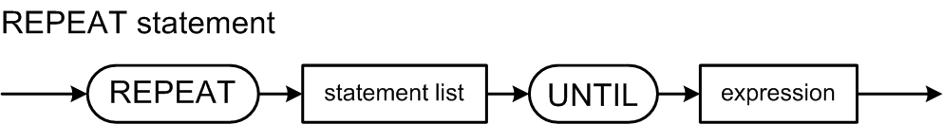
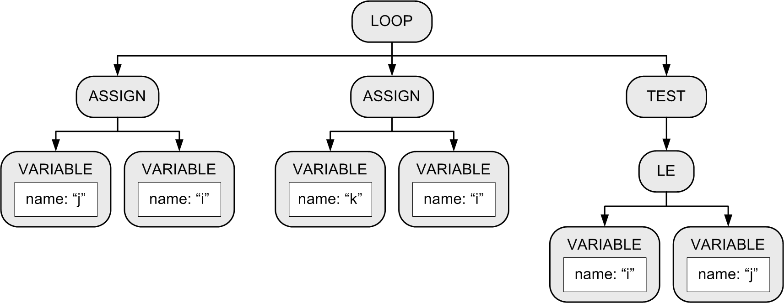
REPEAT Statement
Example:
Keep looping until the boolean expression becomes true.
Execute the loop at least once.
REPEAT j := i; k := i UNTIL i <= j
Use LOOP and TEST nodes for
source language independence.
Exit the loop
when the test
expression
evaluates to
true.

Slide 16
REPEAT Statement, cont’d
Executor.java
private Object visitLoop(Node loopNode)
{
boolean b = false;
do
{
for (Node node : loopNode.children)
{
Object value = visit(node); // statement or test
// Evaluate the test condition. Stop looping if true.
b = (node.type == TEST) && ((boolean) value);
if (b) break;
}
} while (!b);
return null;
}
private Object visitTest(Node testNode)
{
return (Boolean) visit(testNode.children.get(0));
}

Slide 17
Assignment #3: Parser and Executor
Modify the frontend parser to parse and build trees for the following Pascal statements:
while
if
for
case
You may need to add new node types in the intermediate tier.
Add new visit methods to the backend executor to execute the above statements.
Some simple Pascal source files
are forthcoming to test your interpreter.

Slide 18
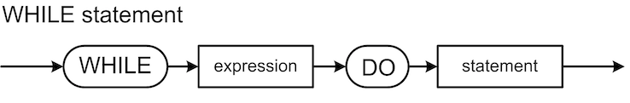
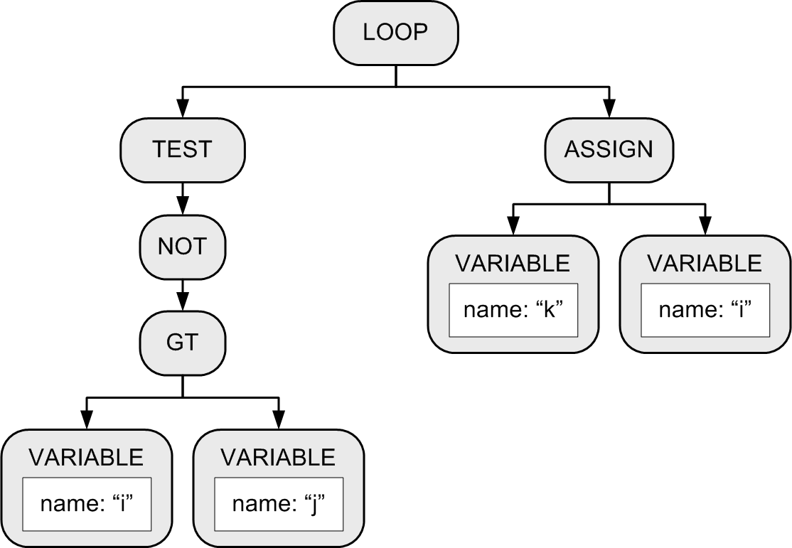
Parse Tree for the WHILE Statement
while i > j do k := i
Why?

Slide 19
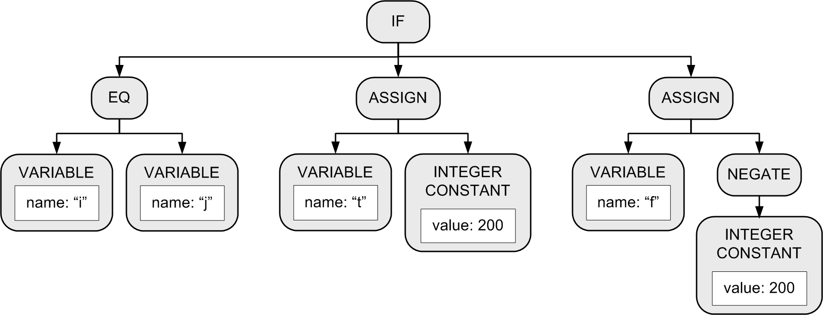
IF Statement
Example:
IF (i = j) THEN t := 200 ELSE f := -200;
Third child only if
there is an ELSE.

Slide 20
The “Dangling” ELSE
Consider:
Which THEN does the ELSE pair with?
Is it: IF i = 3 THEN IF j = 2 THEN t := 500 ELSE f := -500
Or is it: IF i = 3 THEN IF j = 2 THEN t := 500 ELSE f := -500
IF i = 3 THEN IF j = 2 THEN t := 500 ELSE f := -500

Slide 21
The “Dangling” ELSE, cont’d
According to Pascal syntax, the nested IF statement is the THEN statement of the outer IF statement IF i = 3 THEN IF j = 2 THEN t := 500 ELSE f := -500
Therefore, the ELSE pairs with the closest (i.e., the second) THEN.

Slide 22
Executing an IF Parse Tree
Evaluate the first child’s expression subtree.
If the expression value is true ...
Execute the second child’s statement subtree.
If the expression value is false …
If there is a third child statement subtree, then execute it.
If there isn’t a third child subtree, then we’re done with this tree.

Slide 23
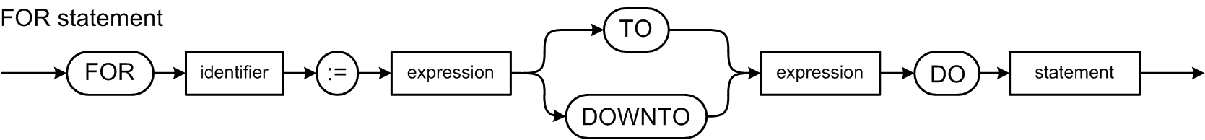
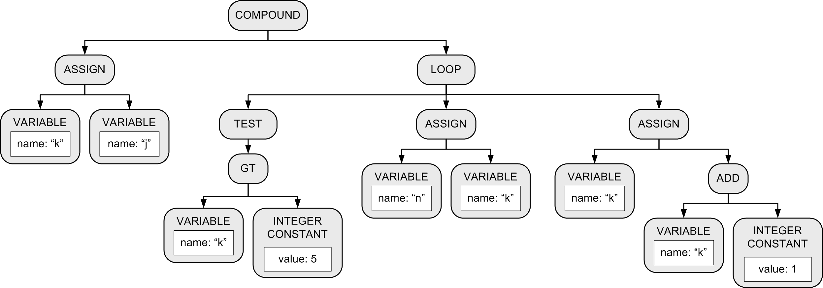
FOR Statement
Example:
FOR k := j TO 5 DO n := k
Increment/decrement:
Node type ADD for TO
and SUBTRACT for
DOWNTO.
Initial assignment.
Node type GT
for TO and LT
for DOWNTO.
DO statement.

Slide 24
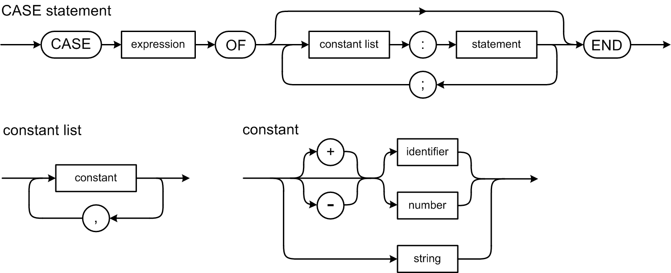
CASE Statement
Example:
CASE i+1 OF 1: j := i; 4: j := 4*i; 5, 2, 3: j := 523*i; END
Note that Pascal’s
CASE statement
does not use
BREAK statements.

Slide 25
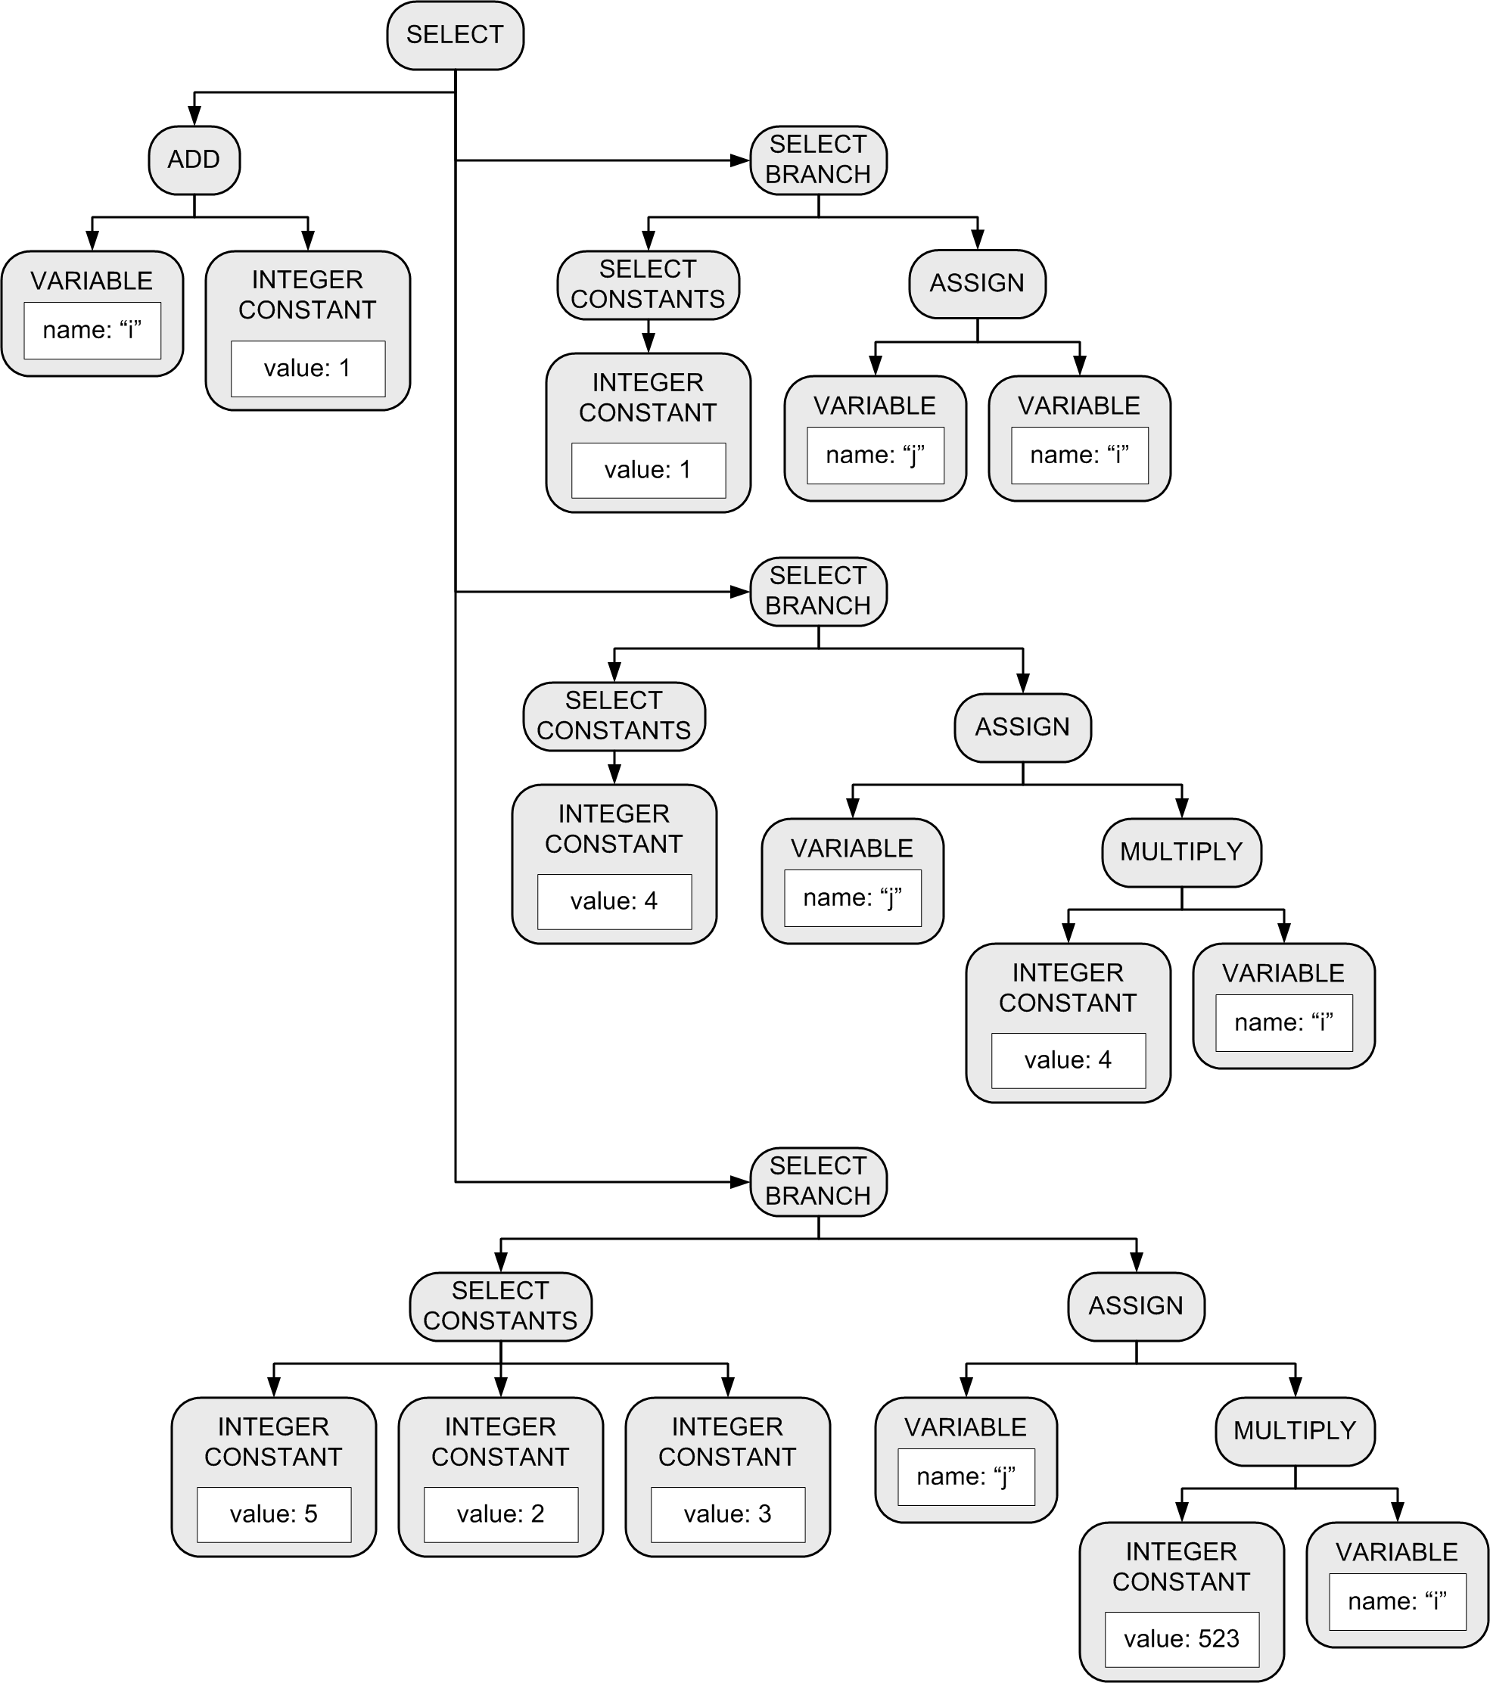
CASE Statement, cont’d
Example:
CASE i+1 OF 1: j := i; 4: j := 4*i; 5, 2, 3: j := 523*i; END

